Slide 1

How To Study
The Bible
Tools Needed
Rightly Dividing
The Words
The Context

Slide 2
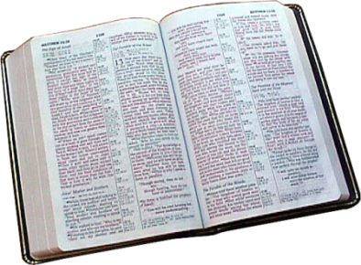
God’s
Words
Ps. 33:4-9
“By the word of the LORD were the heavens made”
“For He spoke, and it was done”
Are Powerful
Biblos = “book”
Hebrew = 8,674 different words
Greek = 5,624
KJV = 12,143 English words
Notes:
1. God’s Words are powerful
a. “But He answered and said, “It is written, 'Man shall not live by bread alone, but by
every word that proceeds from the mouth of God.'” Matt. 4:4 NKJV
b. Ps 33:4-9 “For the word of the LORD is right; and all his works are done in truth. By the word of the LORD were the heavens made; and all the host of them by the breath of his mouth. For he spoke, and it was done”
c. His Word is so Powerful that He Created the World by speaking.
2. The words of the Bible are verbally inspired. It is God speaking to us.
3. The word Bible is from a Greek Word Biblos. It means book.
4. The Bible is a book of words
a. In the Hebrew text of the O.T. there are 8,674 different words
b. In the Greek text of the N.T. there are 5,624 different words
c. The KJV has 12,143 different English words
5. We must know the meanings of the words to understand God’s will

Slide 3
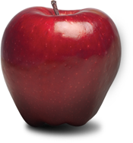

Etymology
Words
“a written or printed character or combination of characters representing a spoken word”
Symbols
Bible not written in English
Translators used words to convey sense of the original writing.
Apple
Chair
Notes:
I. THE STUDY OF BIBLICAL WORDS
A. Etymology is that branch of “word science” that has to do with the origin and development of words.
1. This is an investigation of the origin of the word
2. This helps to determine the meaning of the word
B. Definition of the word “word”
1. “a written or printed character or combination of characters representing a spoken word”
C. Words are symbols
1. Words are not actual things, but only their symbols
a. You cannot eat the word “apple”.
b. You cannot sit on the word “chair”
c. You cannot worship or pray to the word “God”.
2. Words are only representatives or symbols of the things they stand for.
3. Words in the Bible are only useful when they convey to our understanding the things for which they stand.
D. If we are to understand the Bible, we must know the meaning of the words that are used in the Bible.
1. The words in the original Bible were not English, so we are dependent upon translators for us to read the Bible.
2. In our English translations, the translators have used words that convey to us the sense of the words used in the original writing of the Bible.
3. In reading the Bible we are reading words, but our aim should always be to know what these words mean.

Slide 4
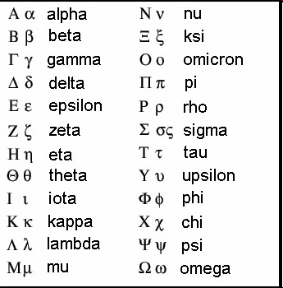
Etymology

Slide 5
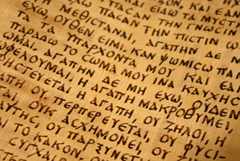
Etymology
Greek Manuscript of 1 Cor. 13

Slide 6
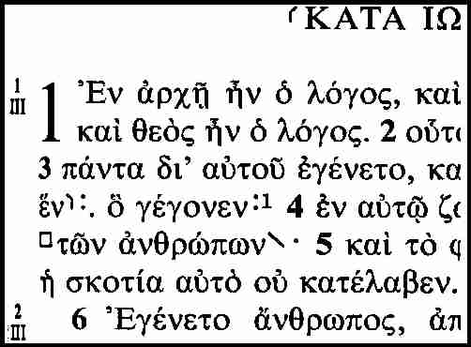
Etymology

Slide 7
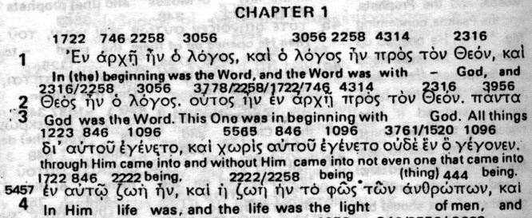
Etymology
Interlinear of John 1:1

Slide 8
Etymology
Parts of speech
Tenses
Punctuation marks
Grammar
“I will build my Church” Matt. 16:18
“unworthily” 1 Cor. 11:27
Adverb = unworthy manner
If an Adjective = personal unworthiness
“Let him that stole steal no more” Eph. 4:28
Let him that stole, steal.
Notes:
A. Grammar
1. To learn the meaning of Biblical words, we must realize that they are used in relationship to each other in phrases, clauses, and sentences.
2. So we need to understand a little about grammar, parts of speech, tenses, punctuation marks
3. This does not mean we have to be able to label each word as to whether it is a verb, noun, adjective or adverb.
4. But to understand Matthew 16:18 where Jesus says “I will build my church” we must understand that “will build” is describing some action in the future. In grammar that is called the future tense.
5. The word “unworthily”in 1 Cor. 11:27 is an example of how we must understand grammar.
a. “Whosoever shall eat this bread, and drink this cup of the Lord, unworthily, shall be guilty of the body and blood of the Lord.”
b. “Unworthily” is an adverb, describing the “unworthy manner” in which some of the Corinthian Christians were partaking of the Lord’s supper.
c. Many who have not understood this word concluded that it is the personal unworthiness of the partakers. If that were the case then no one would be worthy to partake.
d. But the word here “unworthily” is an adverb describing the way in which we partake the Lord’s Supper
6. “Let him that stole steal no more.” Eph.4:28 “Let him that stole, steal.”

Slide 9
The B.I.B.L.E.
B = Basic
I = Information
B = Before
L = Leaving
E = Earth
Notes:
Acrostic of Bible = Basic information before leaving earth.

Slide 10
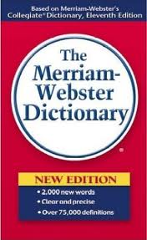
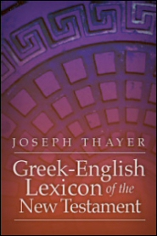
Meaning of Words
Baptism
to immerse, sprinkle, or pour water on in the Christian rite of baptism:
To immerse, submerge
Notes:
WORDS MEAN SOMETHING
A. Dictionaries give meanings
1. An English dictionary gives a definition of English words and how we use them.
2. But the Bible was written in Hebrew and Greek.
3. Sometimes an English dictionary will define a word that is not in harmony with what the Bible teaches.
B. An example is the word “baptism”
1. An English dictionary will define it as sprinkling, pouring or immersion.
2. But the Greek dictionary defines it as to immerse, submerge
3. Col. 2:12 says that we are “Buried with him in baptism”

Slide 11
Church - Matt. 16:18
Ekklesia
# 1537 - Out
# 2564 - Call
The Called Out
Notes:
A. The word “Church” Matt. 16:18
1. From two words in the Greek = ekklesia
2. #1537 - EK = a preposition meaning “out of”
3. #2564 - KLESIS = “a calling”
4. It means a calling out of, - it denotes a spiritual body of people who have been called by the gospel out of the world into a holy relationship with God.

Slide 12
Bishop
Episkopos
Epi = upon
Skopos = to look or watch
Oversee
Notes:
A. The Word “Bishop”
1. From two Greek words = episkopos
2. Epi = upon
3. Skopos = to look or watch
4. It denotes a class of men possessing qualifications to oversee or supervise the business of a local church.

Slide 13
World
1. Earth
John 17:24
1 John 2:15-16
John 3:16
2. People
3. Sin
Notes:
E. The word “World” Has different meanings (1) Earth & universe (2) People (3) Sin
1. John 17:24 “for You loved Me before the foundation of the world.”
2. John 3:16 “For God so loved the world”
3. 1 John 2:15-16 “Love not the world”
4. What is the difference in these three verses with the word world?
5. The meaning is determined by the context.

Slide 14
Light
1. Radiant energy that illuminates.
2. Used as the opposite of heavy or the shade of some color.
3. Metaphorically in reference to understanding.
4. Deem something unimportant.
The Bible uses light in all of those ways
(Gen. 1:3; 2 Cor. 4:17; Lk. 2:32; Mt. 22:5)
Notes:
A. Another Word with different meanings is the word “light.”
1. It can refer to radiant energy that illuminates.
2. As an adjective it could be used as the opposite of heavy or the shade of some
color.
3. It can be used metaphorically in reference to understanding.
4. And if you make light of something it means you deem it unimportant.
5. The Bible uses light in all of those ways (Gen. 1:3; 2 Cor. 4:17; Lk. 2:32; Mt. 22:5).
6. The context is what makes the meaning clear in all those verses.

Slide 15
Hate
Lk. 14:26
“hate not his father”
Love Less
Matt. 10:37
Notes:
A. Sometimes we Must look at other passages to help understand the meaning of a word.
1. Luke 14:26 “If any man come to me, and hate not his father...”
a. We are told to hate our family
b. What does it mean here?
c. # 3404 = detest
2. Look at Matt. 10:37 to help understand the meaning of the word hate “He who loves father or mother more than Me is not worthy of Me. And he who loves son or daughter more than Me is not worthy of Me.

Slide 16
Words Change
Heb. 13:5
Conversation = Conduct
  Ex. 28:42 Breeches - Trousers
  Matt. 1:18 Espoused - Engaged
  1 Tim. 2:12 Suffer – Do not permit
Notes:
A. We must remember that language is fluid. Words change meaning over time.
1. An example is the word conversation.
a. In the King James translation, Hebrews 13:5 says, “Let your conversation be without covetousness,” which makes it sound like we should not reveal our sinful desires when we speak.
b. But that's not the meaning of that verse.
c. A more modern rendering would be, “Let your conduct be without covetousness.”
d. The English word conversation once meant “conduct” or “manner of life.”
e. Over time, the meaning changed until now conversation refers to our talk instead of our behavior.
f. The context sometimes helps to correctly define words that have changed meaning.
g. The next statement in Hebrews 13:5 says, “be content with such things as you have.” That sounds more like conduct than speech
2. Many of the words in the KJV have changed in meaning or spelling
a. Breeches - Ex. 28:42 = NKJV has trousers
b. Espoused - Matt. 1:18 = NKJV betrothed
c. Suffer - 1 Tim. 2:12 = “Do not permit” NKJV
3. Words like “Thee”, “Thou”, and “Thine” are now outdated and we use words like you or yours.

Slide 17
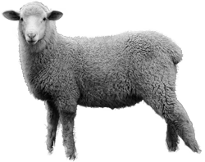
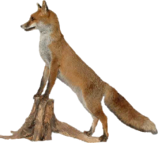
Figures of Speech
Literal and Figurative
Different
Sheep - Jn.1:29
Lord’s Supper
Lk.13:32 “fox”
Genesis
Acts
Sheep
Notes:
Figures of Speech
A. All languages have two types of speech: literal & figurative
1. Literal language is the type found in the historical books of the Bible, such as Genesis and Exodus; the book of Acts. It is factual language
a. In literal language if the word “sheep” is used, it means a four legged animal from which wool is taken.
2. Figurative language is different.
a. Words are used to represent ideas or thoughts which are different from the actual meaning of the word.
b. For example: a sheep or lamb might be mentioned, but the animal is not meant. It is used to represent something else which has some of the
qualities of a sheep or lamb.
c. Jesus was a man. But in figurative language He is spoken of as a Lamb.
d. John 1:29 -- “Behold the Lamb of God who takes away the sins of the world.”
e. Under the Law of Moses, Lambs were used for sin offerings.
f. John does not mean that Jesus was a literal, four legged animal. But, he meant that Jesus would be the offering for our sins.
3. The verses about the Lord's Supper has figurative language
a. Body represented by Bread;
b. Blood is represented by the Fruit of the vine
4. Jesus used figurative language in Luke 13:32.
a. Jesus had been warned that King Herod was trying to kill him.
b. Jesus replied by saying, “Go, tell that Fox...”
c. Did Jesus really mean that Herod was a furry animal about the size of a small dog with a bushy tail? No. He meant that Herod was a sly, sneaky fellow.
5. 1 Peter 5:8 - the devil is compared to a lion

Slide 18
Figures of Speech
“You scared me to death”
“He has tons of money”
“I am starved to death”
“Dog Kicked the bucket”
“Salt of the earth” Matt. 5:13
“Tree planted by rivers of water” Ps. 119:103
“The tongue is a fire” Jas. 3:6
Notes:
A. We use figurative language.
1. “You scared me to death” - “He has tons of money”
2. “I am starved to death”
3. In talking about the death of a dog we might say: “He kicked the bucket”.
C. The Bible uses figures of speech
1. “Salt of the earth” Matt. 5:13
2. “Like a tree planted by the rivers of water” Psalms 1:3
3. “How sweet are Your words to my taste, Sweeter than honey to my mouth!” Ps.119:103
4. “The tongue is a fire” James 3:6

Slide 19
Figures of Speech
Parables
Matt. 13:24-30 - Sower
Parable - parabole
Para = beside
Ballein = to throw
To throw alongside - Compare
Notes:
A. Parables are figures of speech
1. Sower and Seed - Matt. 13:24-30
2. The word Parable is from two Greek words: Para = beside and Ballein = to throw
3. It is placing beside or together, a comparing.
4. It is a story by which something real in life is used as a means of presenting a moral thought.
5. The purpose of a parable is to reveal truth - to help the person to understand the unknown by a comparison with the known.

Slide 20
Figurative Language
Literal unless context forbids it
Jn. 4:14
Figurative when literal is impossible
Lk. 9:60 “Let the dead bury the dead”
Jn. 15:5 “I am the vine, you are the branches”
Notes:
A. How can we recognize figurative language?
1. Language is to be understood as literal unless the meaning of the context forbids it.
a. John 4:14 “but whoever drinks of the water that I shall give him will never thirst. But the water that I shall give him will become in him a fountain of water springing up into everlasting life.”
b. “living water” can only be understood to be figurative
2. A word or sentence is to be regarded as figurative when the literal would involve an impossibility.
a. Luke 9:60 “Let the dead bury their dead”
b. John 15:5 “I am the vine, you are the branches”
3. Common sense will suggest that the passage is figurative - like Psalms 23

Slide 21
Book of Words
Ps. 119:162
2 Tim. 1:13
783,137
words
Notes:
1. The Bible is a book of words. In order to know what God wants us to do to please Him we must understand the meanings of these words.
2. We must read and study and find the meanings so we can learn God’s will
3. Psalms 119:162 “I rejoice at Your word As one who finds great treasure.”
4. 2 Timothy 1:13 “Hold the pattern of sound words which you have heard from me”
5. There are 783,137 words in the Bible and they are all important.

Slide 22
Suggestions For
Studying the Bible
30 minutes
Schedule
5 Minutes - Review / Preview
15 Minutes - Rapid Reading
10 Minutes - Taking Stock
Look up words
Re-read parts
Summarize, Meditate
Notes:
SCHEDULE - you have set aside 30 minutes
A. 5 minutes - Review / Preview
1. Look back at your notes from the previous study
2. Look ahead to the verses or section that you are planning to study
C. 15 minutes - Rapid Reading
1. Read the new material
2. Have a pencil in hand to mark words that you do not understand the meaning and that you want to go back and learn
D. 10 minutes - Taking stock
1. Look up words that are unfamiliar to you. Write down the meaning
2. Re-read parts that were not clear
3. Summarize what you have read in your own words
4. Think of the importance of what you have read and how it relates to your life.

Slide 23
